Slide 1
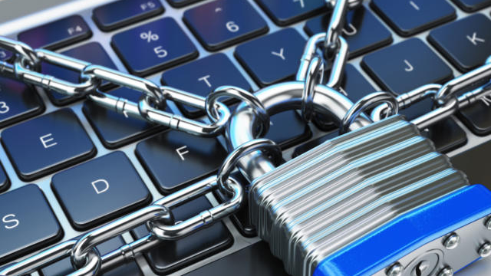
A Practical Guide to Cyber Security in 2019
For your teens and adults

Slide 2
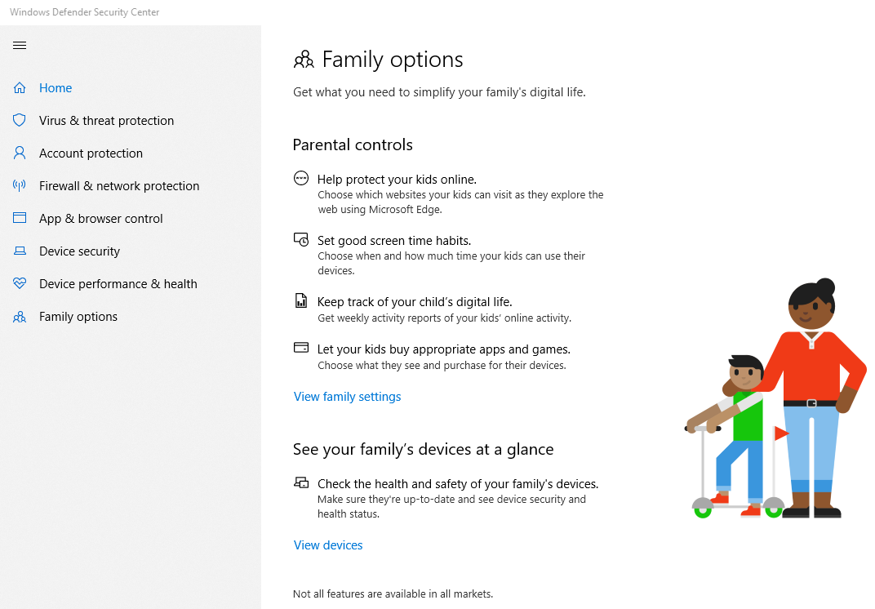
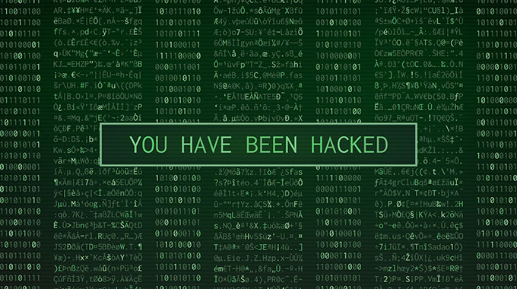
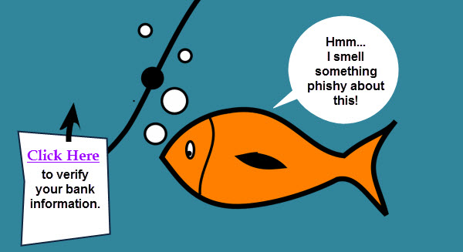
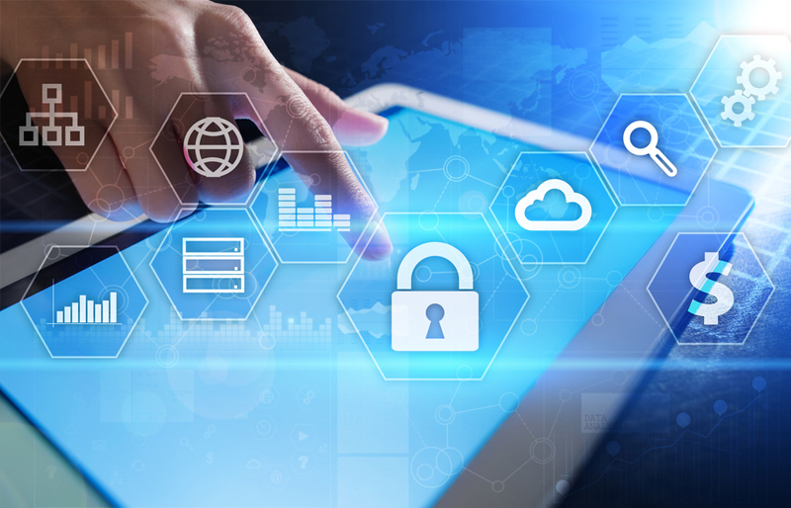
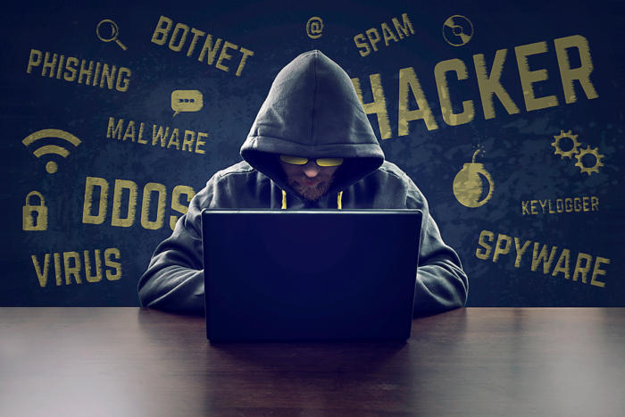
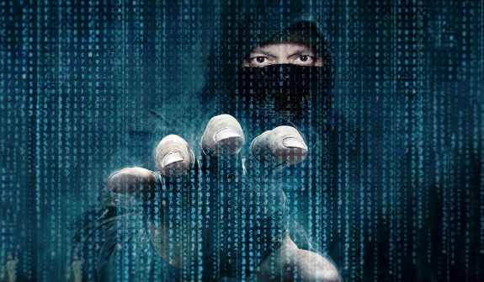
Agenda
www.URTech.ca
Notes:
Tonight's event should take about 45 minutes and hopefully be more than just the same old, don’t leave your kids alone on the internet speech.
There is a lot of content so if you can hold your questions until the end I promise to answer everyone I am able
This will not be a death by PowerPoint presentation - only graphics and examples on the screen
No need to take specific notes because this presentation and all of the links will be on www.URTech.ca tomorrow and we have a highlights handout
We are going to spend a few minutes on kid specific stuff
then about 10 minutes on outlining some of the problems
and the balance of the time discussing practical solutions to keep you, your organization and your family safe

Slide 3
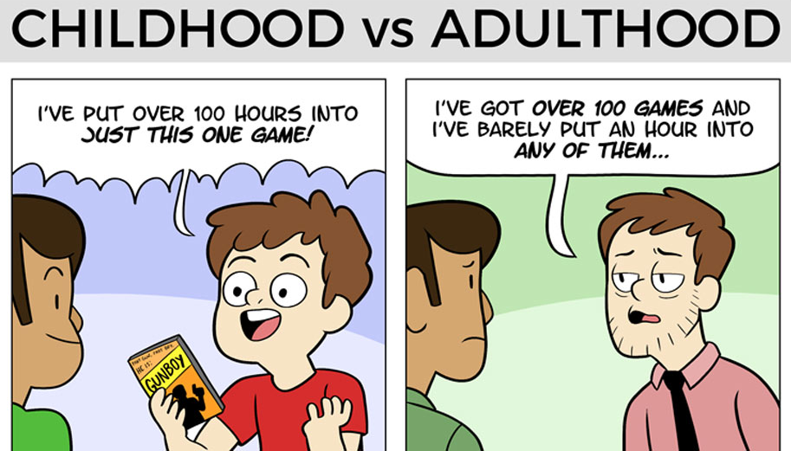
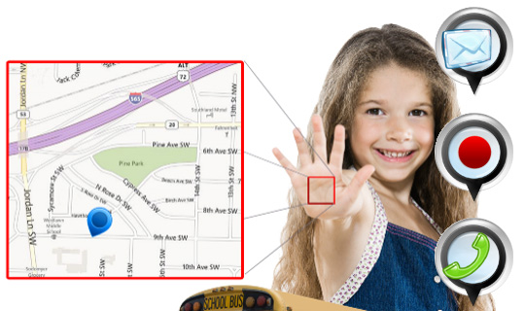
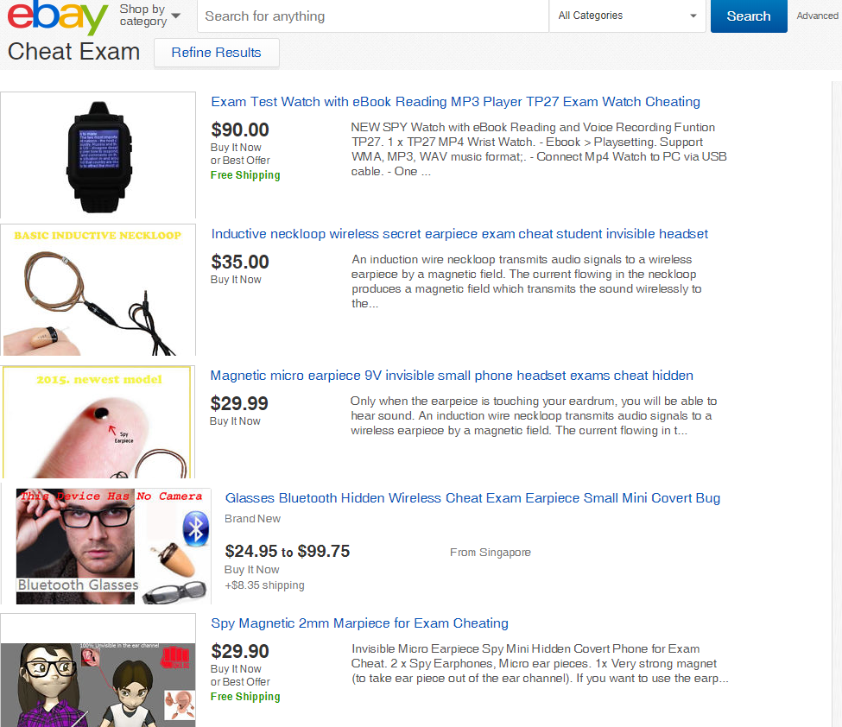
Adult vs Child
Notes:
Hopefully this first slide will be the only slide you might have expected to see tonight. The rest of this presentation will be different from what you may have anticipated… and hopefully more useful. We are going to start with a few kid/parent things and then drive into real cyber security.
In these types of presentations, we used to distinguish between teenager and adult. That is no longer the case as ALL OF US need to be keenly aware of cyber issues
The only real difference is that Parents and kids security today is that parents are responsible for their childrens digital footprints
- not just because your child is under 18. It is likely that YOUR name is the one on the cell phone and Wi-Fi contract
- Also, in the mid-2000's parents have responsibilities under the criminal code that include such things as securing their wireless internet connections, regardless of what the child wants to do
- This schools administrators correctly point out that parents will answer for any images or words found on systems their child is using, like texting
Practically these laws are seldom enforced against parents but they do exist and there can be serious ramifications.
1 CLICK
This type of presentation usually spends a lot of time considering ways to control and monitor your kids, I am not going to do that.
There a many tools to help you can do to block your child from doing things but they will almost always find a way around them so don't put too much effort into it.
GPS trackers on cells result in the cell being left at a friends house
Software blocks have the kids use someone else's computer / cell
2 -CLICK
When my kids were little I used parental controls in Windows to simply email me a log of their activities. I told the kids about the logging but I never brought it up after that conversation. Instead I let them forget about it and I would just skim through the list from time to time with nothing jumping out at me. Then one day I found some very disturbing sites had been visited (and no, they were not the type of sites you are thinking about right now). We sat down to lay out the issues with our kids and we think put an end to it with an honest discussion.
If you are going to monitor your kids I suggest you imply that you are using more than one system to do so because they will figure out the one you tell them about and get around it.
You have a choice. Be VERY stealthy and secretive or be right in their face.
This is a constant debate in the IT industry, but my goal as a parent is to raise a well adjusted cyber smart kid and if I take the decisions away from my kids when they are young, they will likely make poor decisions later in life. This is the same reason I don't lock up the booze... unless Brian is around.
Because we are in school, we should have a 30 second chat about cheating. Your kids need to know that, they need to get lucky every time they cheat and the authorities only need to catch them once:
Plagiarism checkers are readily available to teachers and, having others write parts of your reports will likely get noted in these plagiarism checking systems
A painful example of this happened in with my kid in December. My youngest kid is in grade 11 and she was just flagged as cheating because some other kid copied two paragraphs from a report SHE wrote.
The school put this on her permanent record which would likely see her blacklisted from some Universities
Fortunately we were able to sit down with her teachers and principal and have it removed because all were convinced it was the ‘other kids’ cheating and not my daughter.
3 CLICK
Cheating gear is everywhere and it is CHEAP but teachers have the right to ask your kid to explain their electronics and do an inspection
Cell phones convert texts to speech so kids can use their Blue Tooth Ear Buds to cheat. One of my kids had serious test anxiety so I understand how a wall of music can help. However, there is nothing to stop a teacher from asking the kids to leave all their cells on his desk for the duration of the exam.
In the end, it is going to be up to you as the parent to parent. You need to talk to your kids and teach THEM how to make sensible decisions in the real world and in the cyber world.
The remainder of this presentation does not mention kids specifically, because these are things EVERYONE needs to know about.

Slide 4
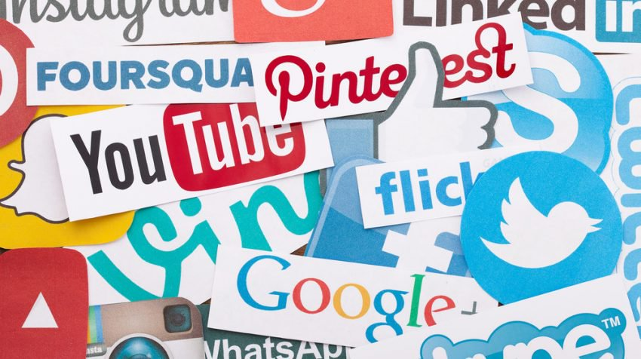
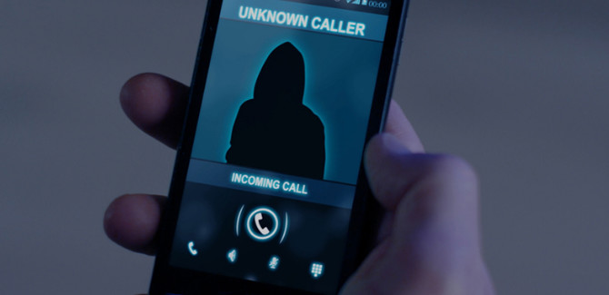
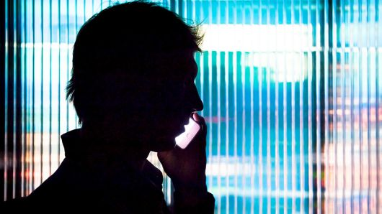
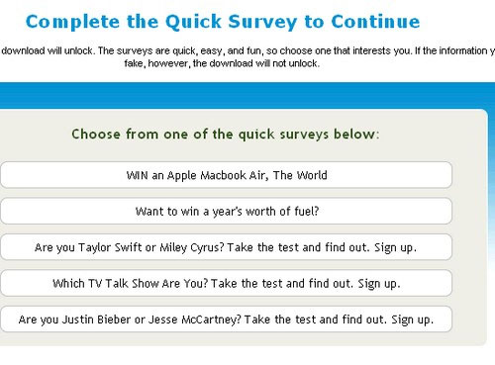
Doxing
Notes:
How many people have heard of doxing?
it is slang for documenting and it usually indicates malicious intent – things like identity theft in which your house is remortgaged or your car has a loan taken out on it without your knowledge
Short version is a hacker can pay someone often in third world countries like India, Pakistan, China, between $100 to $1000 to find out everything about you… and they will
Doxing is cheap & fast compared to the rewards of getting into your credit
You might expect hackers to go through your Social Media
But they will call your home, your kids, your parents, your bank and even office
Hi, I have a complaint about Ted and his assistant, I need his bosses name
They want to know your personal and corporate organization structure
This is not pie in the sky, movie stuff… this is real and it is happening to hundreds of people Calgary right this minute.
Think about how much money or credit you have easy access to and you will quickly see why YOU are the honey pot these days
Fake Surveys about everything from political parties to fishing clubs
I have political friends who have created dozens of fake social media accounts to gather information on opponents and there supporters.
This is shockingly more common that you think it is
There have been many cases in which otherwise sensible people have volunteered seriously confidential documents (both personal and corporate) to hackers
I know your thinking how stupid could these people be, but they are not stupid they are being attacked by very sophisticated groups.
Hackers build up trust by sending you what appear to be sensitive documents from inside their fake company or there fake personal lives (things like Will’s that contain codes and numbers, or more to the point in Calgary, papers or confidential presentations on Oil & Gas exploration) and ask you to do a quick peer review
After a few of these, as your friendship grows, you get more comfortable and feel a bit obliged to ask them to review some documents about your company or personal life
Among many of many other cases that have become public, this process has been used to extract classified NATO Military documents
The point is… how much did this cost the hacker… a few hours of effort and a few months of waiting
For serious attacks I am personally aware of actors being hired to physically become someone friend at University for 2 months – to attack VERY wealthy parents
2017 STORY: Hacker/actors befriended a kid in University, taking many of the same classes. As you likely know, anyone can sit in a University classroom and claim they are a student, especially in first year where everyone is anonymous.
They learned all they could from the son, then got on his laptop and using his real email account, they sent malware hidden in a photo to the victims Dad
“Have a rash, off to the doctor, take a look and see if it is something family related
That malware allowed the hacker to control that Dad’s office email
They then monitored the Dad’s email to pick up his slang and way to writing
When they were ready, they sent low key friendly emails to CFO about a business his company was supposed to be buying and they needed deposit money transferred today
That Vancouver based parts company lost $7 million dollars in one day
Then the same thing happened to a Los Angeles airplane parts manufacturer a few months later but this time they got more than $20M
Likely the same hackers
In the second situation the CEO and CFO were terminated for cause
We will tell you in a few minutes how this problem could have been easily avoided but it boils down to, communication.
If someone is asking for money through a system you are not expecting, you need to confirm the request with verbal communication

Slide 5
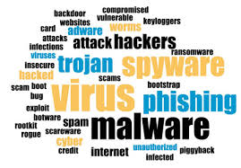
The Problem
Notes:
More practical real life stuff
An attacker can buy advertising space on the legit websites. Later, when a user clicks on the ad, he might get directed to a page that’s infected with malware. This way, they can further install malware on your computer.

Slide 6
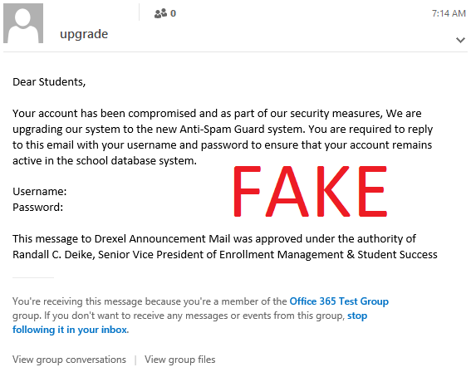
Social Engineering / Phishing
Notes:
Phishing
Hopefully this is not a new word for you. The premise to trick you into volunteering your information.
Listen to this phone call. I have personally received this several times and my office has been getting something like this for two years now.
I call these guys back and just jerk them around as I work on other things, but one of the calls took an new twist that would frighten most people.
SKIP to 19:20
Then they programmed the number into their fake call display tool and I received a call from what looked like the RCMP… pretty cool
The interesting point here, is that
Way more successful than you might think
I runs phishing training at the company I spend most of my time with
Several times a year I send phishing tests
In November Still had 4% of the staff enter their username and password into a phishing test site.
We also just had two people, one senior and one that is responsible for the administration of most multimillion dollar contracts receive emails from hackers that had their real password in it
Again the point here is not to pick on people but to show that smart well trained people can still be tricked by these pro’s

Slide 7
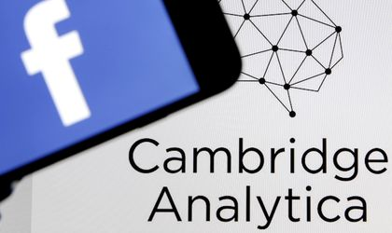
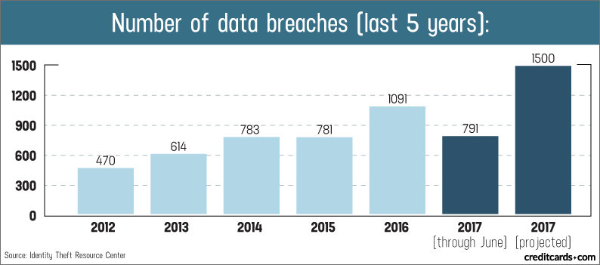
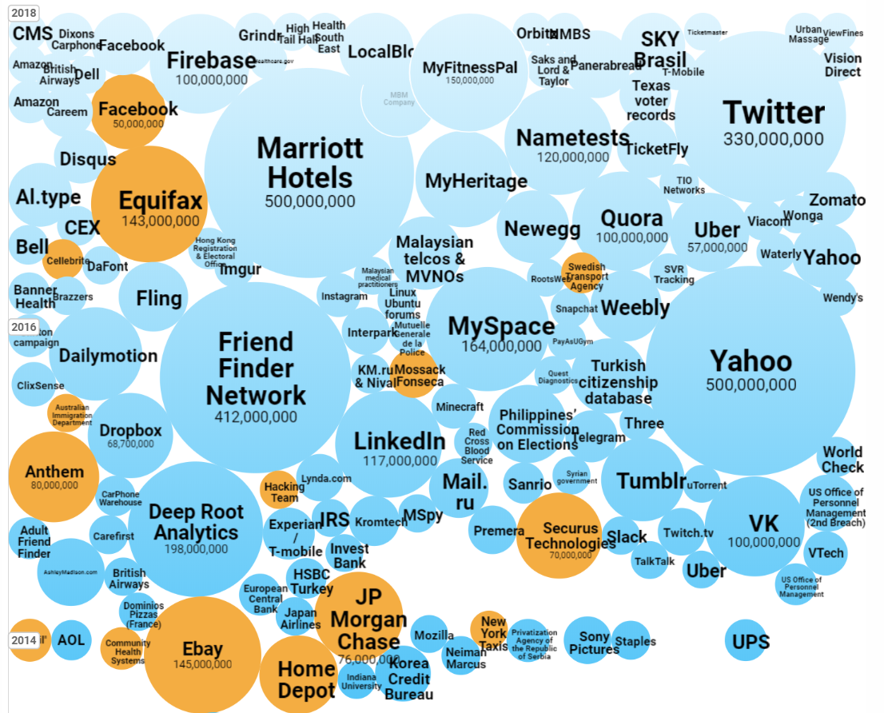
YOU Don't Have To Be Hacked To Get Hacked
Notes:
You don’t even have to have a computer to get hacked these days…
If the people and companies you trust your data to get hacked, you are hacked.
The giant retailer Target (remember Target… new Zellers) was hacked through a construction company they allowed into their network. Hackers got hundreds of millions of names, credit cards and pins… most likely some of you in this room were affected by that hack
If you have stayed at a Westin, Aloft, Sheraton or any other Marriott property in the last decade,
a substantial amount of your private information has likely been stolen. This includes 130+ million passport numbers and 400 million peoples address, credit cards, email and travel patterns

Slide 8
YOU Don't Have To Be Hacked To Get Hacked
Notes:
Listen to this hacker get into a complete strangers account just by knowing is name and phone number

Slide 9
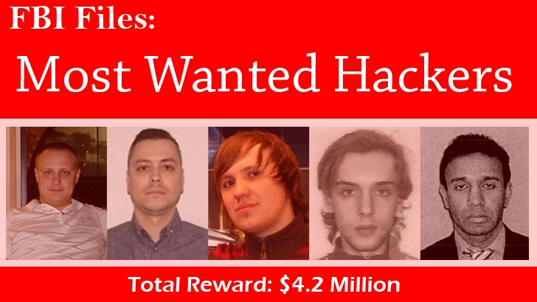
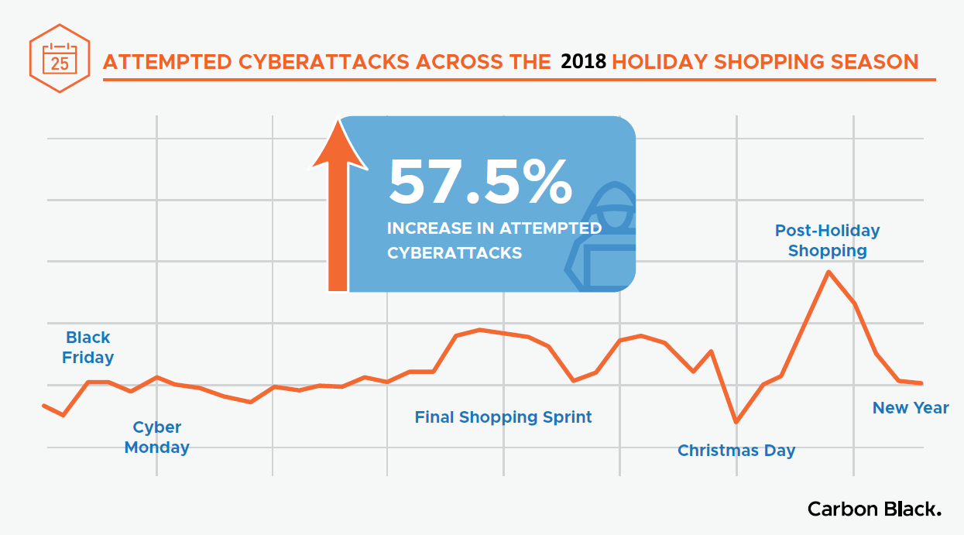
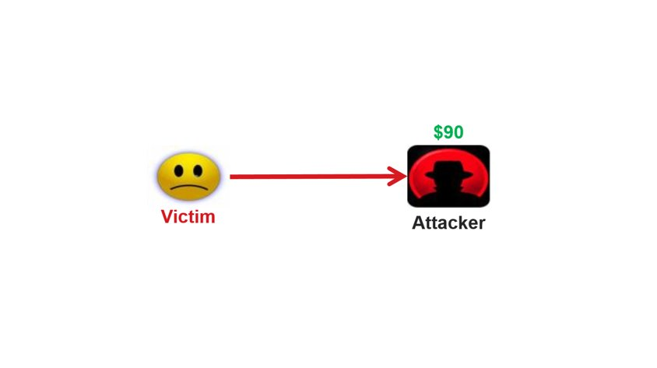
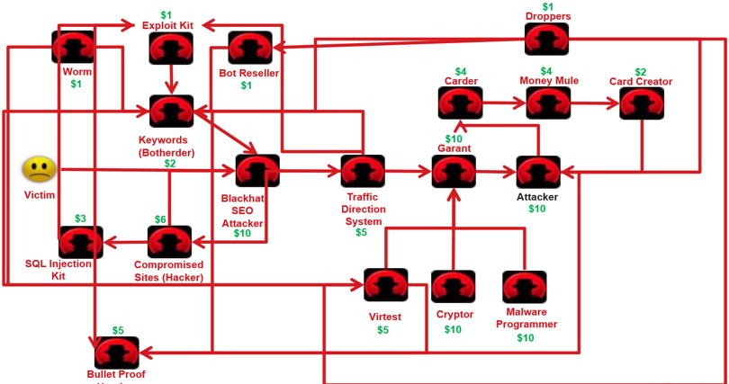
Who Are These Hackers?
Notes:
Most people think that a hacker coming after you or your company or your kid is single person… and that used to be the case
Today it is large scale and organized.
The graphic on the bottom right shows the number of people involved in a typical hack these days
CLICK
This report from Carbon Black was released today. Hackers love the confusion and lack of attention during the holidays.

Slide 10
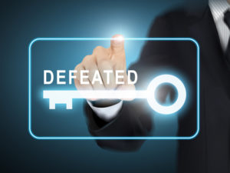
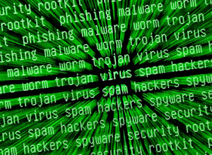
The Solution
Notes:
Enough of the; gees hackers are good, you don’t stand a chance.
You do stand a chance and you can protect yourself.
There is no single solution because the problem keeps expanding. Whatever we come up with, attackers will get around it
But there are lots of things you can and should do

Slide 11
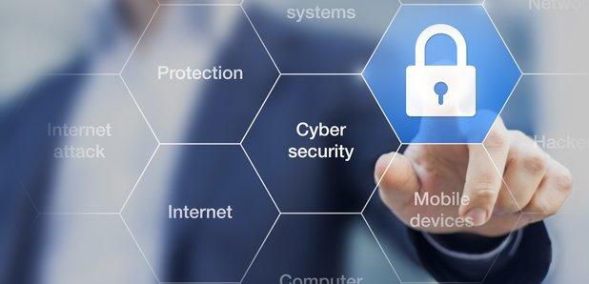
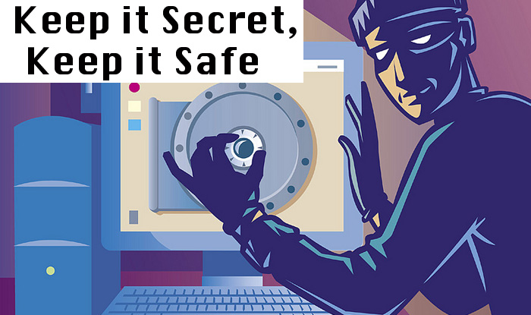
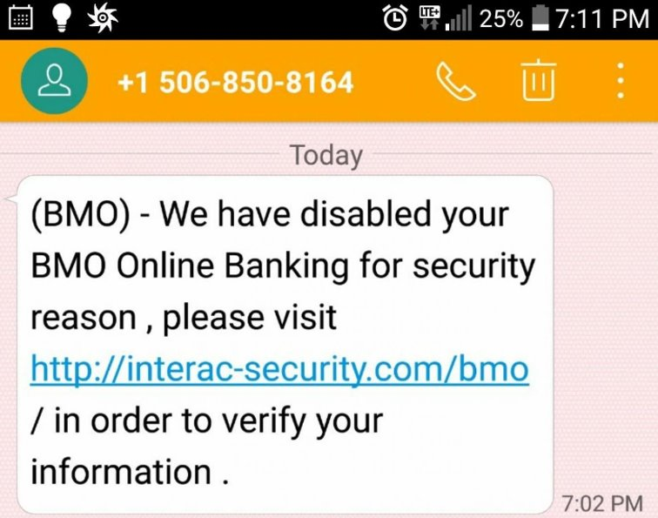
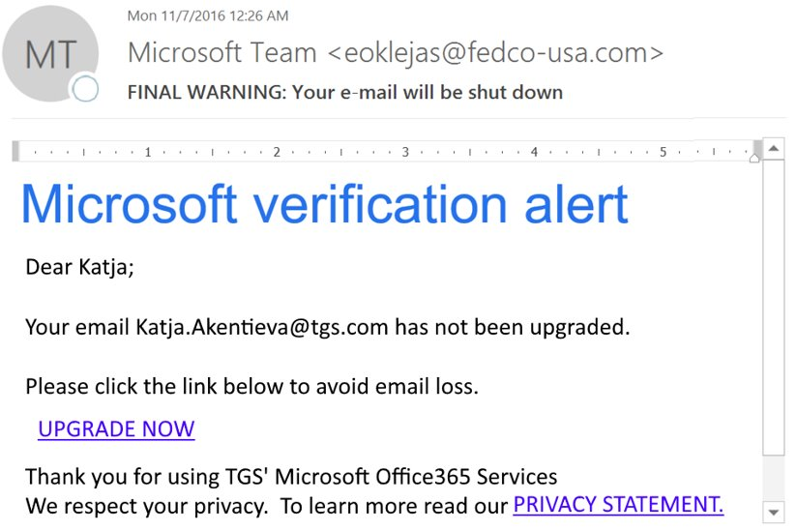
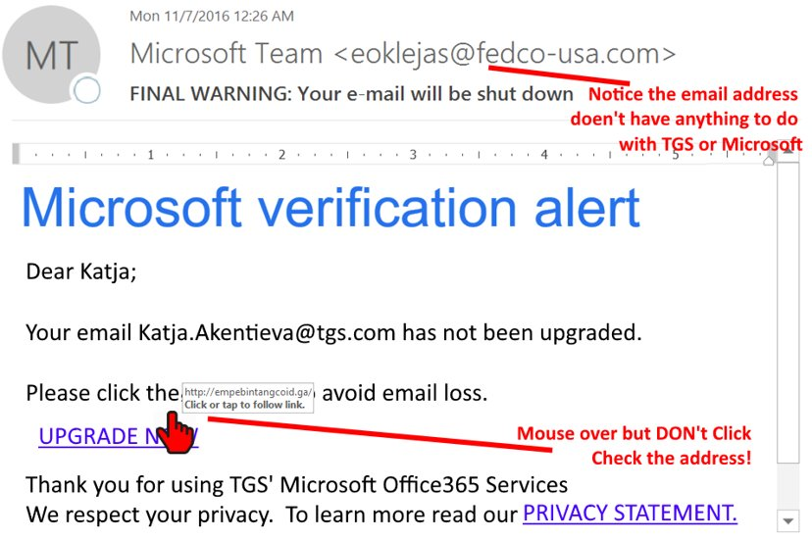
The Don'ts
Notes:
Lets start with the DON’Ts
What you should NOT do:
Do not use real details on social media or lesser accounts (I.e. you magazine subscription, your Gmail registration, your gym membership)
use what I call, NEAR INFORMATION
My birthday is Sept 11 so I enter it as Sept 1st
I live in Chestermere but register everything I can as Calgary
Obviously does not work for shipping
Don't take surveys online or on the phone
Shut Up - If you don't want your worse enemy to know something, don't post it
THIS IS THE BIG ONE - Do Not Click Links you are not expecting - Mouse over links and if you still think it might be real, go to the site in question by manually typing in the address or phoning the company
Do not believe calls from banks, tech companies, the Government or police
call display fraud is easy to do but still new enough to impress people
if it is worth transferring money or legal stuff, it is worth driving or calling yourself
Do not transfer money or information before you verify the issue is real
Call your bank, log into PayPal or Ebay or FedEx or even the CRA but DON’T CLICK THAT LINK!

Slide 12
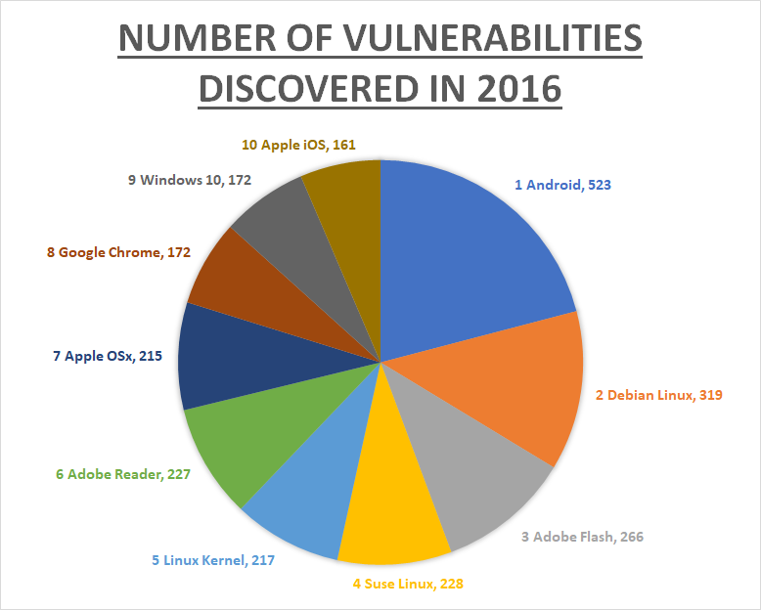
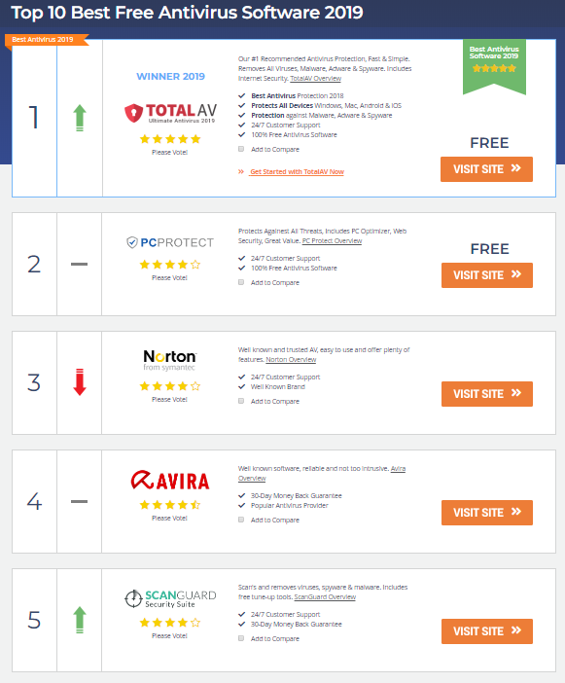
The Do's
Notes:
What to you should do:
Short list of obvious stuff we all know but seldom do:
Patch everything
Computers are common sense but people with Apple products think they are safe when in fact they are the juicy targets.
If you have an old cell that no longer gets constant updates, go buy a new one
Backup your data and not in your house – use a service or push to the cloud
Microsoft has an excellent OneDrive solution that clones your local data up to a TB – free with Office365
Get an AV or Malware checker for your cell
there are lots of free ones so there is no excuse
Don’t install products from anywhere but the official apps store

Slide 13
The Do's
PASSWORDS
Least Important​
Shared & Easier Passwords​
123987a or seafood7 Do NOT add the number 1 to end​
​
Important But Not Critical​
Shared Longer PassPHRASES​
ILikeCheese or Nine9Nine​
Critical ​
Unique Long Passphrases​
ILikeChicken&Cheese​
MyBankIsGood2018​
Notes:
Password Tiering - this is the idea that you REUSE different passwords for different systems. You will be told to keep completely separate passwords for each different system, but few do and you can avoid that complexity by using Tiering
Also not that password length trumps complexity. Just a mathematical fact

Slide 14
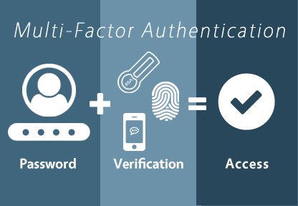
The Do's
TwoFactorAuth.org
Notes:
Two Factor authentication means you can prove you are you using two things
1: something you KNOW like a password and
2: something you HAVE like your cell phone
CLICK
A system that needs to verify who you can prompt you to log in and then send you a text code or ask you to click and APPROVE button in app like Microsoft or Google Authenticator
Twitter = Login verification
Facebook = Login approvals
Google = two step verfication
This short video talks about the MS Authenticator but Google has one too and many companies use one of these two apps.
At very least get a text they can send you a text
Two Factor Auth . Org for list of what does have it and how to get to it. Some companies burry their 2FA

Slide 15
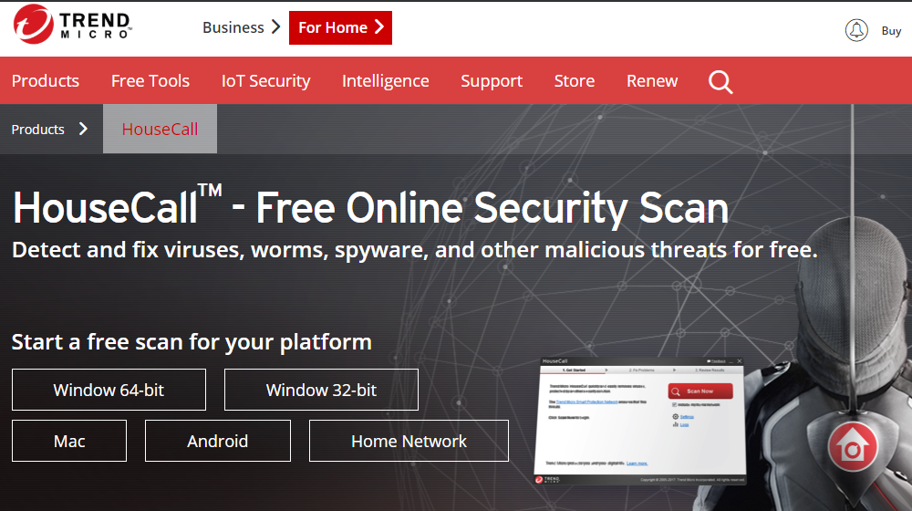
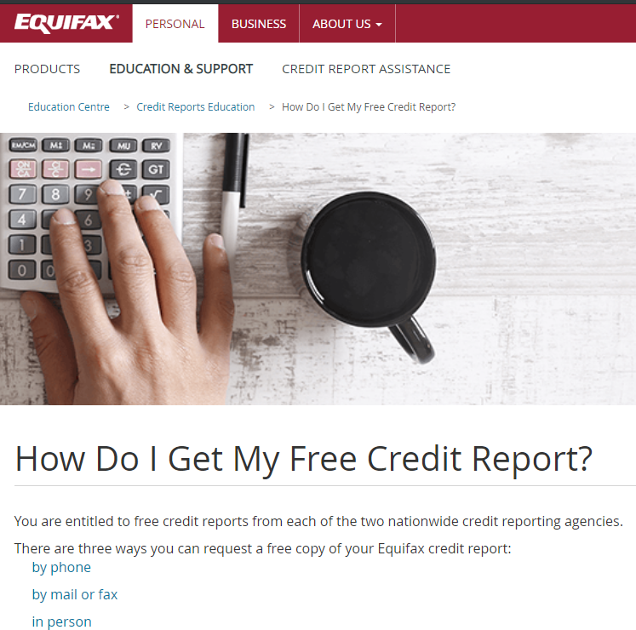
The Do's
TrendMicro.com/housecall
1-800-465-7166
Notes:
Be proactive and poke your digital closet once or twice a year
Random checks:
Use a free antivirus/malware scanners from time to time on phones and computers
Use HOUSE CALL Network - pops up every time something connects
Get a free credit report from Equifax or TransUnion – the big credit rating agencies
Under the Fair Credit Reporting Act, you are entitled to one free annual credit report from the major credit reporting companies

Slide 16
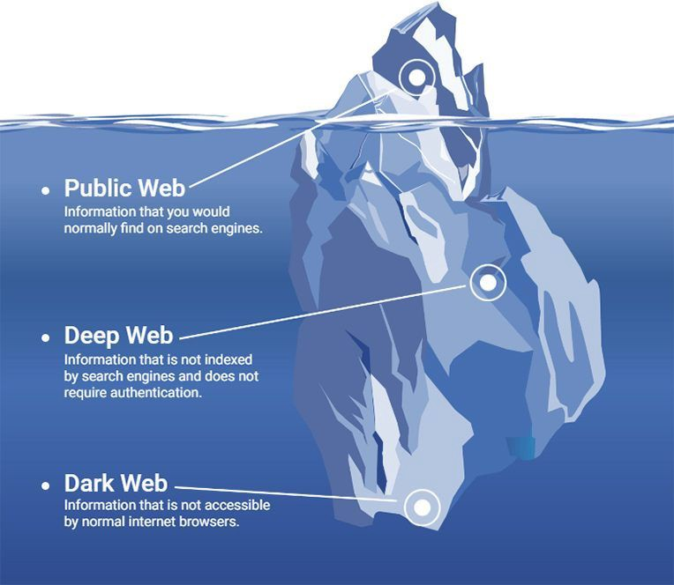
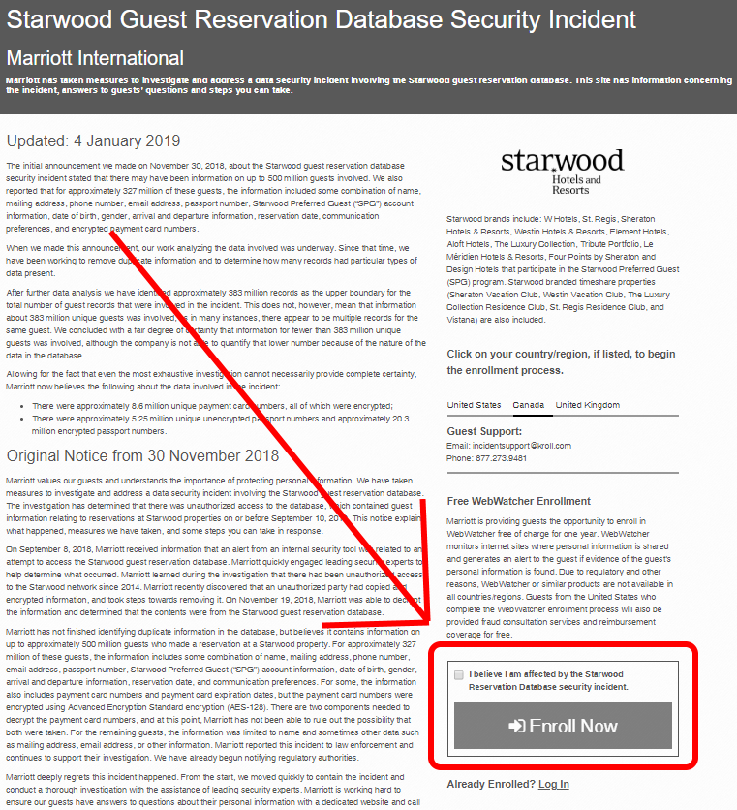
The Do's
answers.kroll.com
Notes:
Check the Dark Web periodically
The Dark Web is just the unindexed part of the internet. It exists but you have to have a link to get to it. Kind of like most of the data in your company. It exists but if you don’t know where it is, you can’t find it.
Unfortunately the recent announcement by Marriott that 380 million users data including 130 million passports, travel patterns, family were stolen gives you an in to the dark web at no cost.
For the next year or two anyone can use the Marriott system to check what information is on several of the major hackers sites from the dark web
Don't be shy... they owe you

Slide 17
The Do's
Notes:
Keep up with new technology options that are easy to implement
30 seconds of this video
Phone Number Filtering and new stuff

Slide 18
What to Do If You Are Hacked
Notes:
Don’t worry… act quickly
if you think your PC is in the process of being infected, don't wait – literally pull the power plug and take the machine to a qualified tech like Memory Express
If your information is compromised CALL your bank, investment companies AND employer
Notify spouse
Possibly involve the police
Don't pay the ransom unless you have no choice – don't expect a code – estimated about 25% of hackers don't provide the unlock codes

Slide 19
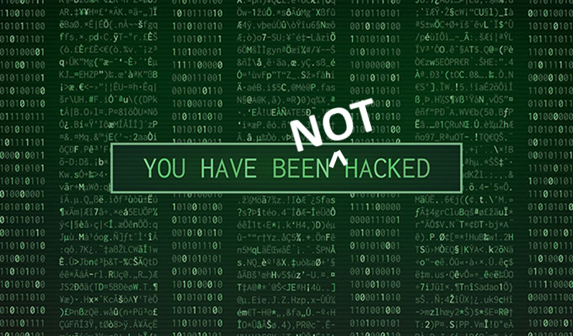
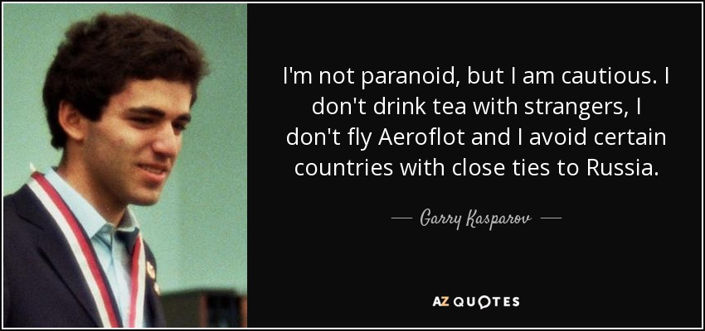
Summary
Notes:
Don’t be paranoid… be cautious.
Verify before doing anything
- don't click links
- don't volunteer information
Use password tiering
Get an AV for your Cell
Get two factor authentication wherever possible
Be proactive and check the dark web and do the odd unexpected scan of your hardware
Most importantly educate your kids and family
Don't be embarrassed if you get caught... get angry – these guys are pro's that even security specialists get caught in
Q&A?
Don't Let Kids Take Electronics off the First Floor
PW or Password – keep them in something safe

